Slide 1

2-D Adventure – Episode 03
Notes:
Today we’ll be adding more elements to our 2D adventure

Slide 2
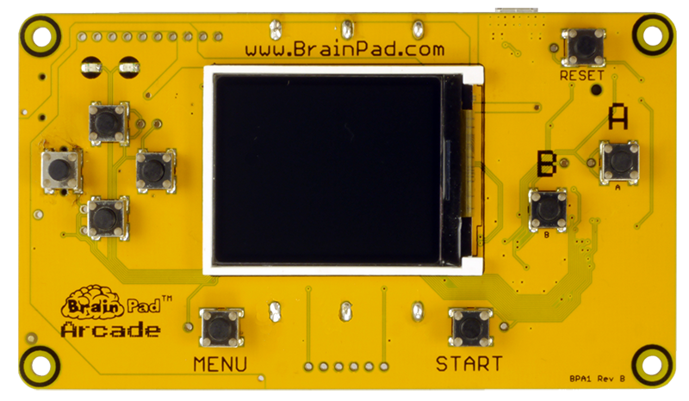
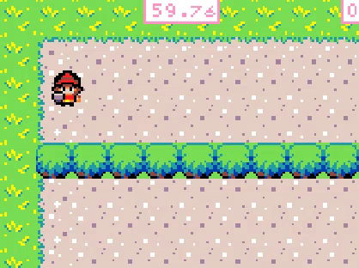
Let’s add a world to explore in our game!
Notes:
In this episode we will be creating a map for our Sprite to move around in we call this a ‘Tile Map’

Slide 3

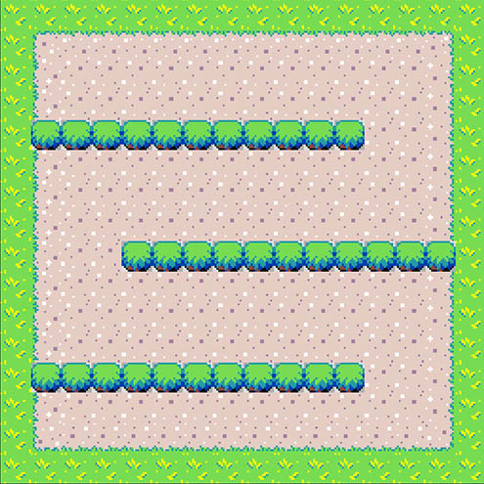
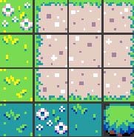
Computer Term:
Tilemaps
Using tilemaps is a very popular technique in 2D game
development to build worlds using regular shaped images
called tiles.
=
EXAMPLE:
Notes:
Tilemaps is a very popular technique in 2D game development that uses tiles to build elaborate worlds and levels using regular shaped block images called tiles. Let’s design our world map using tiles.

Slide 4
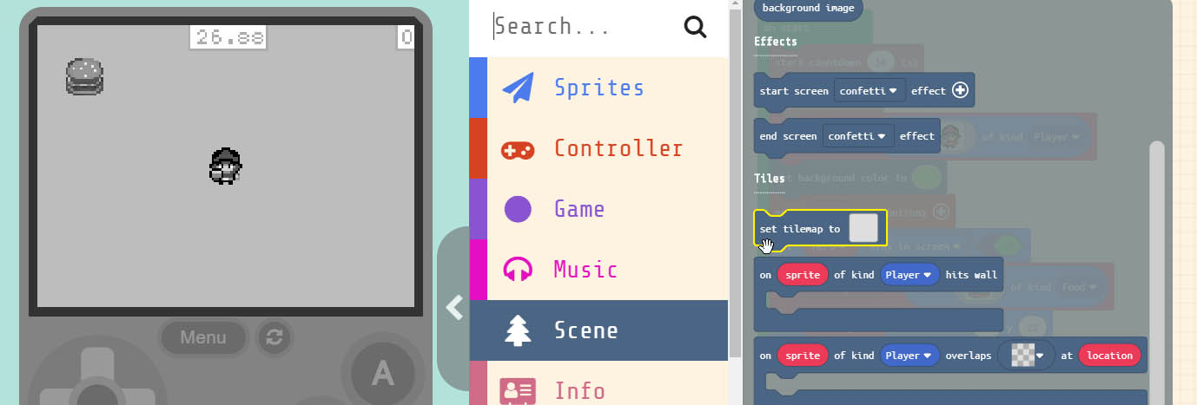
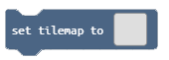
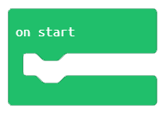
Grab the block
and drag it into the block
Notes:
We need to add the ‘set tilemap to’ block to our project. You’ll find the block under ‘Scene’ in the menu. Drag it into the ‘on start’ block in our project. We can put it anywhere but let’s put ours at the top of the ‘on start’ block. Once the block has been added to the project click on the grey box inside the block. This will open the ‘Tile Map’ editor.

Slide 5
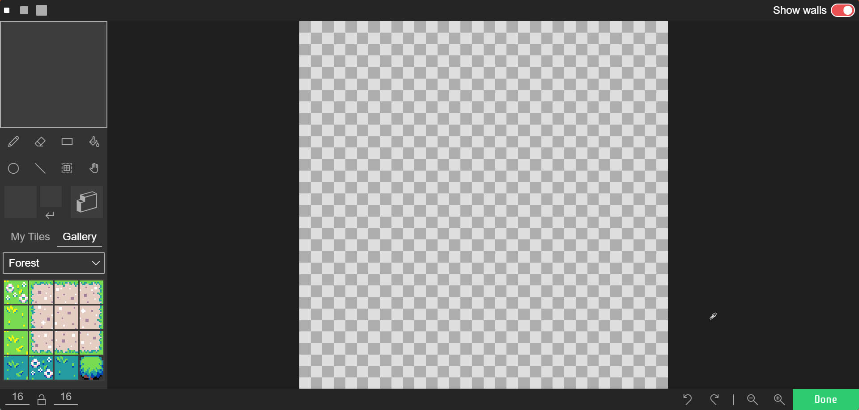
Tile Map Editor
Design Tools
Map Canvas
Tile Gallery
Notes:
Inside the Tile Map Editor is where we create our world map for our game. The Tile Map Editor is made up a few components to make our job easier. First, we have the design tools, like a pencil to draw, or an eraser to remove tiles. The Map Canvas is where we place the tiles into our MAP. Another important section is the ‘Tile Gallery’ here we will find pre-made tiles we can use inside the games we create. The Tile Editor will also allow you to create your own custom tiles if the game you’re making requires it. Let’s draw our map.

Slide 6
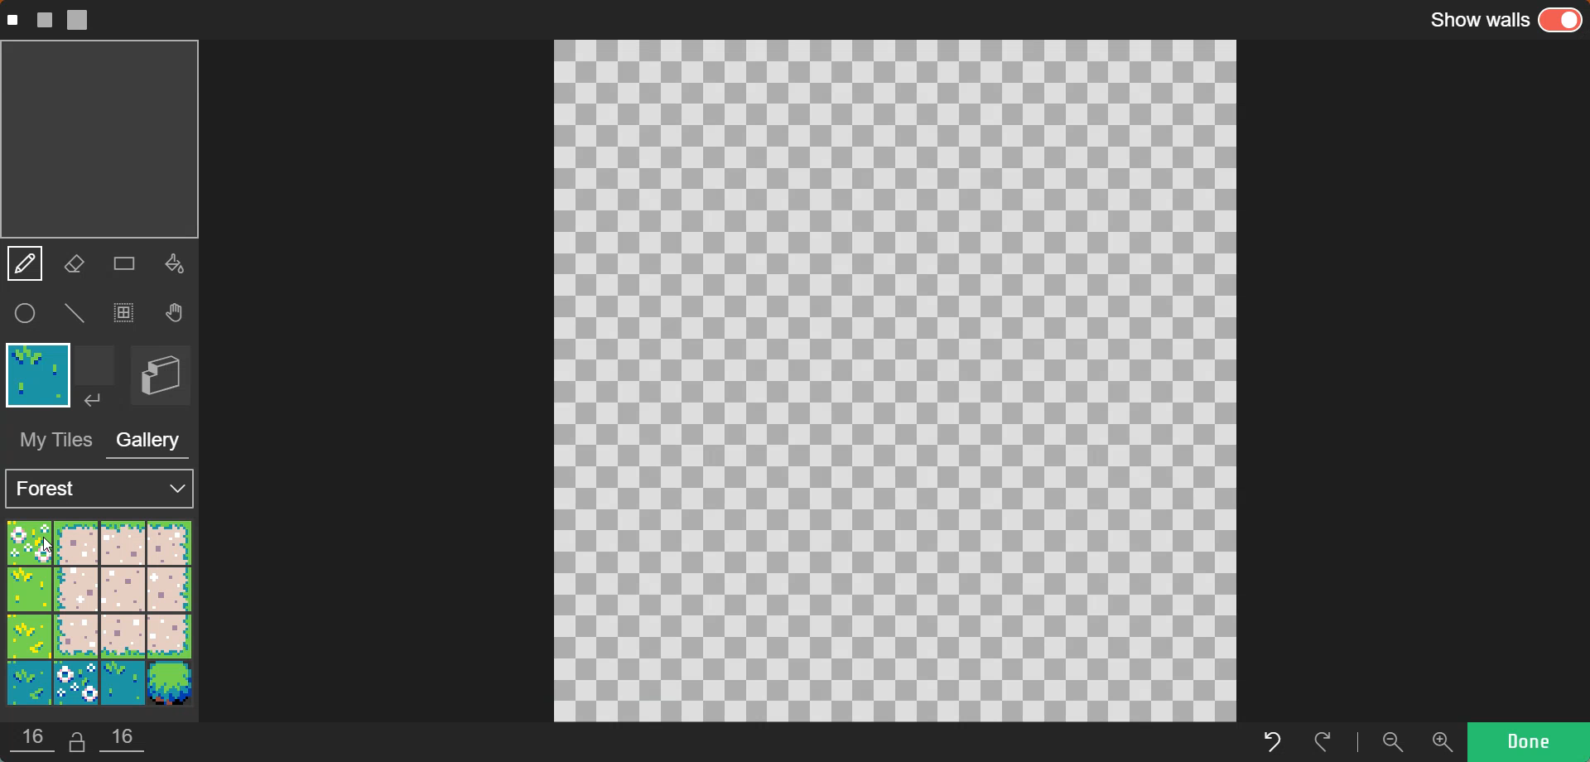
Notes:
Grab one of the ‘Green Grass’ tiles from the ‘Tile Gallery’ and let’s draw all the way around the edge of the ‘Map Canvas’. Next let’s fill the rest of the screen with sand colored ground. We do this by first clicking on the bucket tool and then selecting the ‘Sand/Ground” tile. Next click in the unfilled area and the ‘Sand’ tile will fill up the rest of the screen.

Slide 7
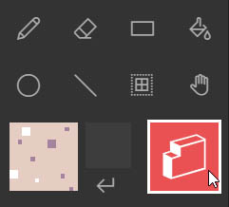

Let’s create a wall around
the outside of our tile map. Any of the tiles can be turned
into a wall
select the “Wall Creation” tool Also make sure “Show walls”
in the top right corner is turned ON
Notes:
Let’s create a wall around the whole map in the green grassy tile we made. Any tile can be made into a wall to do this we select the “Wall Creation” tool. Also click on ‘Show walls’ in the top right corner to see where the walls are in the map. If you need to remove a wall section you created just select the eraser tool with the “Wall Creation” Icon selected and click on the area to erase.

Slide 8
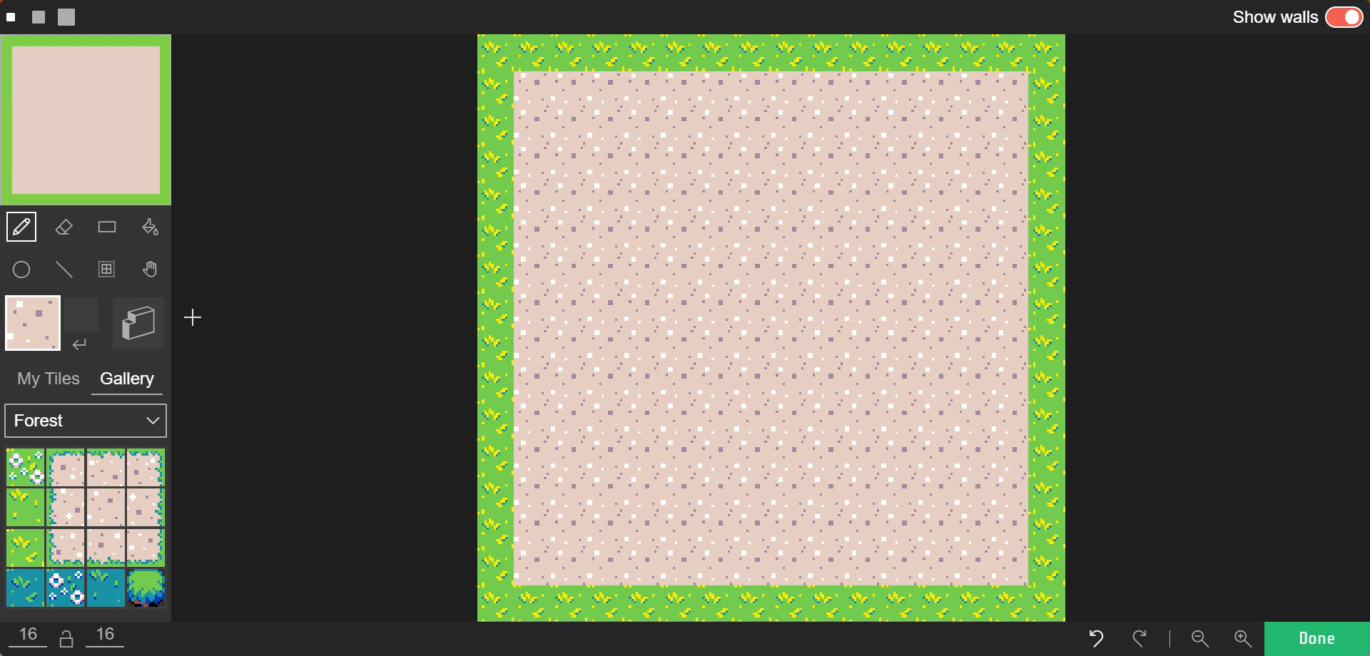
Notes:
After we select the ‘Wall Creation’ tool from the toolbox, use it to draw over the green grass area by clicking on the mouse button to draw. You’ll notice that we can see where our “Wall” is based on the change in color on the screen. Remember any tile can be turned into a ‘Wall’

Slide 9
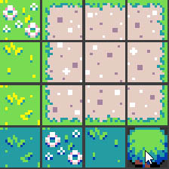
Let’s add some rows of bushes
for our ‘Hero’ Sprite to move around.
Select the bush tile from the ‘Tile Gallery’
and let’s added it to our Map.
Notes:
Let’s add some Bushes to navigate around in our Tile Map. Select the bush tile from the ‘Tile Gallery’ and let’s add it to our map.

Slide 10
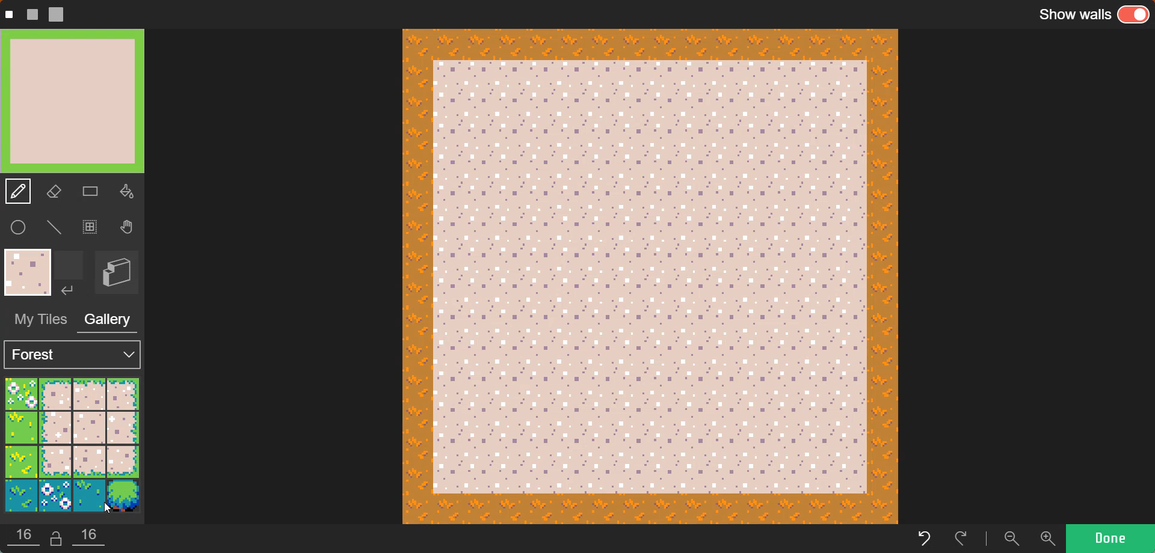
Notes:
Select the “Bush’ tile and draw to add rows to the map. Let’s make them staggered like this so our ‘Hero’ Sprite has a somewhere to go like a maze. Finally let’s make our Bushes act like a ‘Wall’ by using our ‘Wall Creation’ tool on top of the newly created bushes. Once all the Bushes are coloring in click DONE.

Slide 11
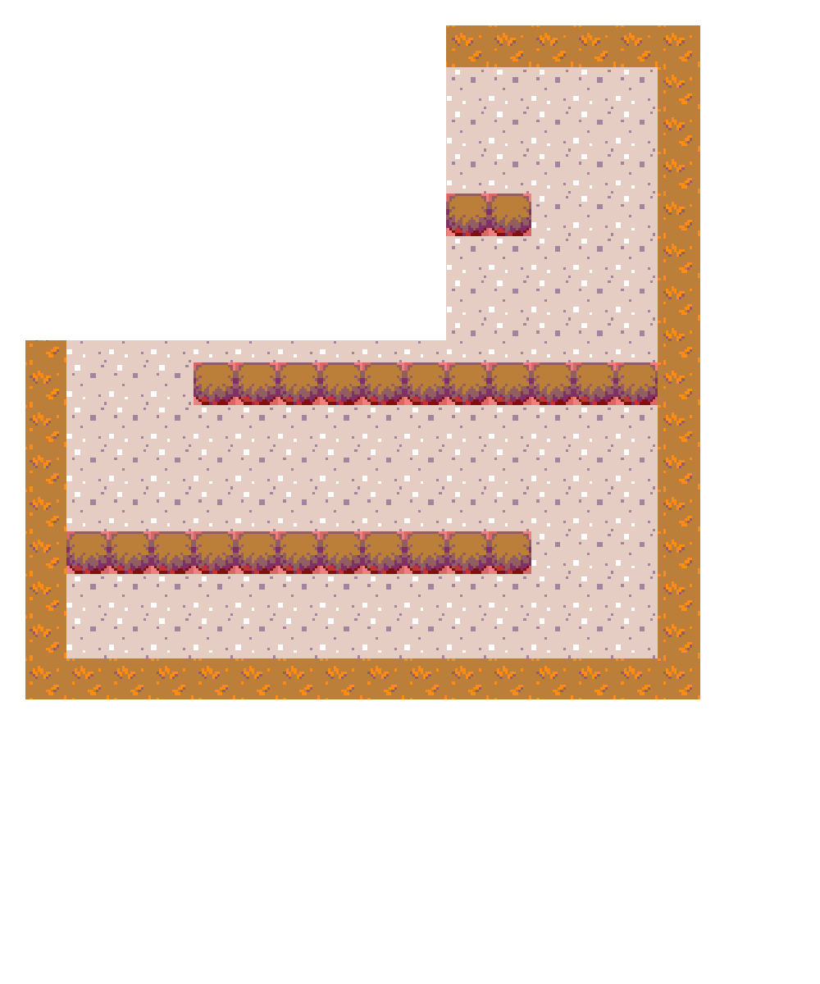
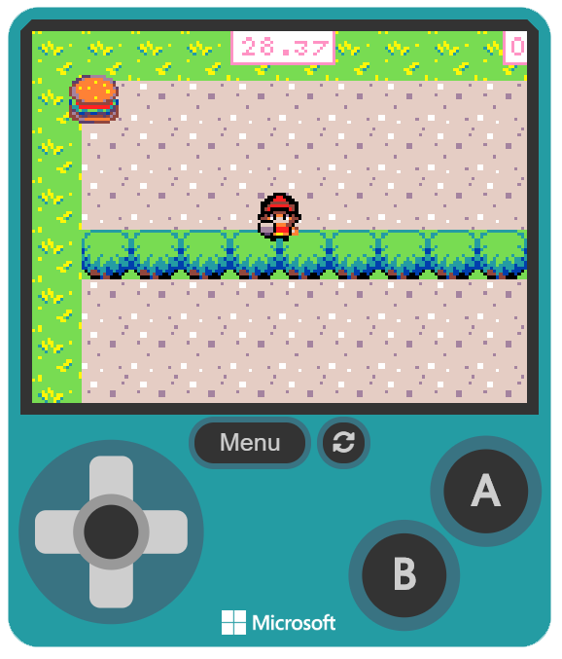
Notes:
You may have notice in the simulator we only see part of the Tile Map we created….This is because the rest is off the screen. The “Tile Map’ is larger than the screen itself. This size is the default size when we created our ‘TileMap’. Tilemaps can also be made much larger if we want to create gigantic worlds. Our current TileMap is approx. around 220x220 pixels. You may have also tried to move our ‘Hero’ Sprite around, but the character is still confined to the screen. Let’s change that.

Slide 12
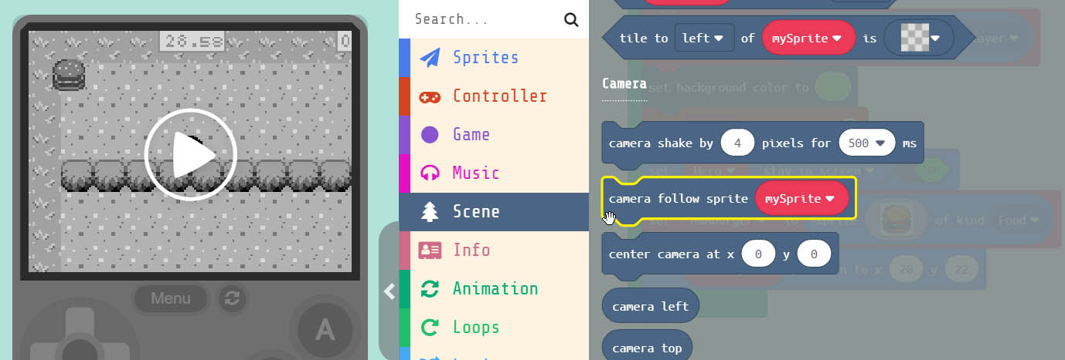

Grab the block
and drag it into the block
Notes:
Under ‘Scene’ grab the ‘camera follow sprite mySprite’ block. Drag this at the bottom of our ‘on start’ block.

Slide 13
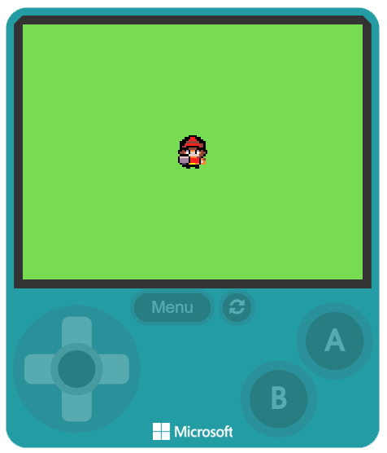
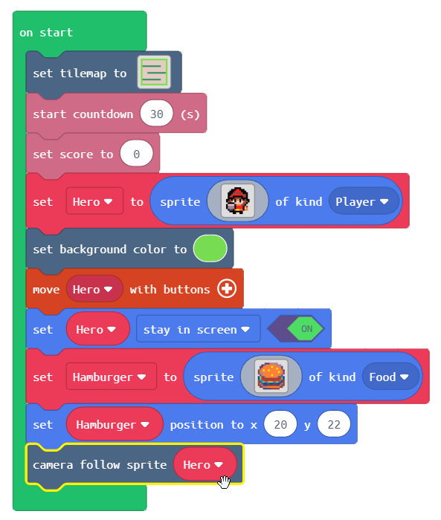
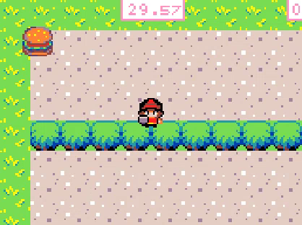
Change the parameter to ‘Hero’
Now the camera will follow our ‘Hero’
Notes:
Change the parameter inside the ‘camera follow sprite’ block that we just created to ‘Hero’. This will tell the camera which Sprite to follow. Now the game camera will follow our ‘Hero’ Sprite as we navigate around our ‘Tilemap’

Slide 14
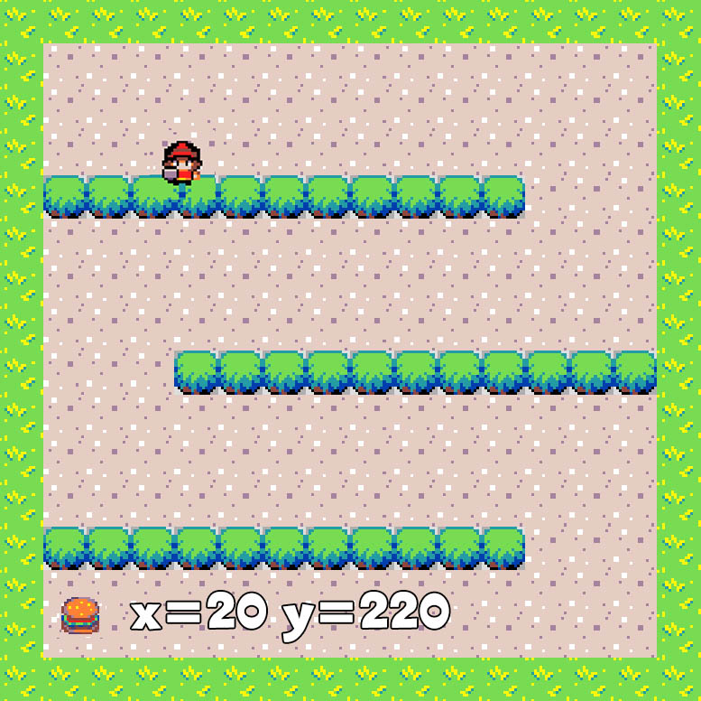
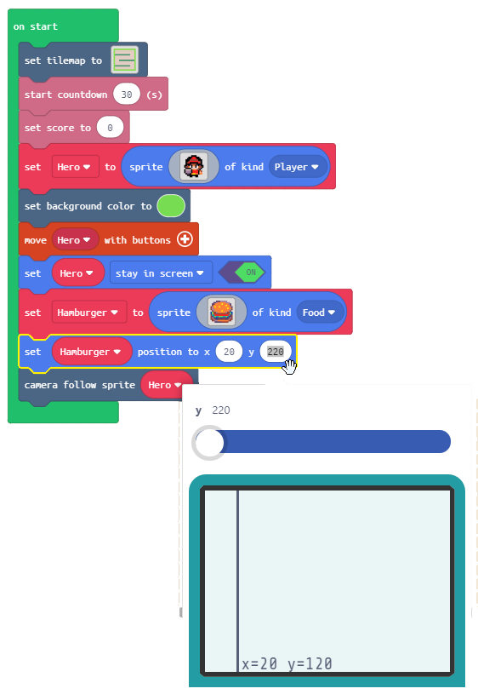
Change the ‘Y’ parameter to 220.
We can’t use the Sprite positioner
because this is only when positioning
with in the screen size.
Notes:
Let’s move the Hamburger to the end of our TileMap. To do this we just need to change the position parameter of the Hamburger. The block is already in our program. Remember that the map is larger so the ‘Y’ value will be larger than the screen size. You also won’t be able to use our Sprite placement tool because it only works within the Screen size. So we’ll have to type the value in manually. Change Y to 220. This puts the Hamburger at the very end of our maze. Now we have a better game. Try it in the simulator first.

Slide 15
Hardware Break
Now let’s load what we have on to the BrainPad.
Notes:
Now let’s load what we have so far on the BrainPad.

Slide 16
EXTRA
CREDIT

Slide 17
Code to Blocks:
JavaScript:
Block:

Slide 18

Code to Blocks:
JavaScript:
Block:

